Slide 1

When2Work
Scheduling Software
Click to Begin

Slide 2
Error!
Please follow the on-screen
instructions to continue.
Go Back

Slide 3
Complete
Please navigate to the next module
in the course to continue.
Restart Course

Slide 4
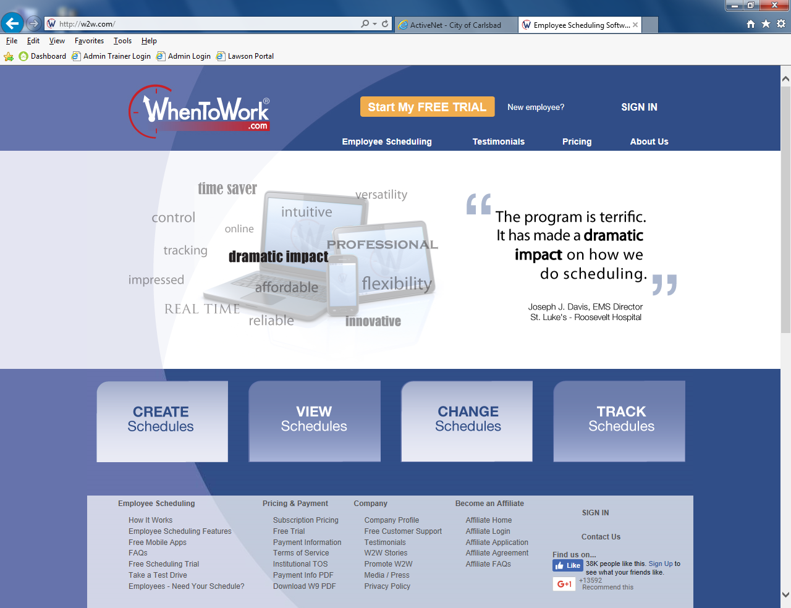
Click to Sign In
Tip:
Welcome to When2Work
Your Employee Scheduling System

Slide 5
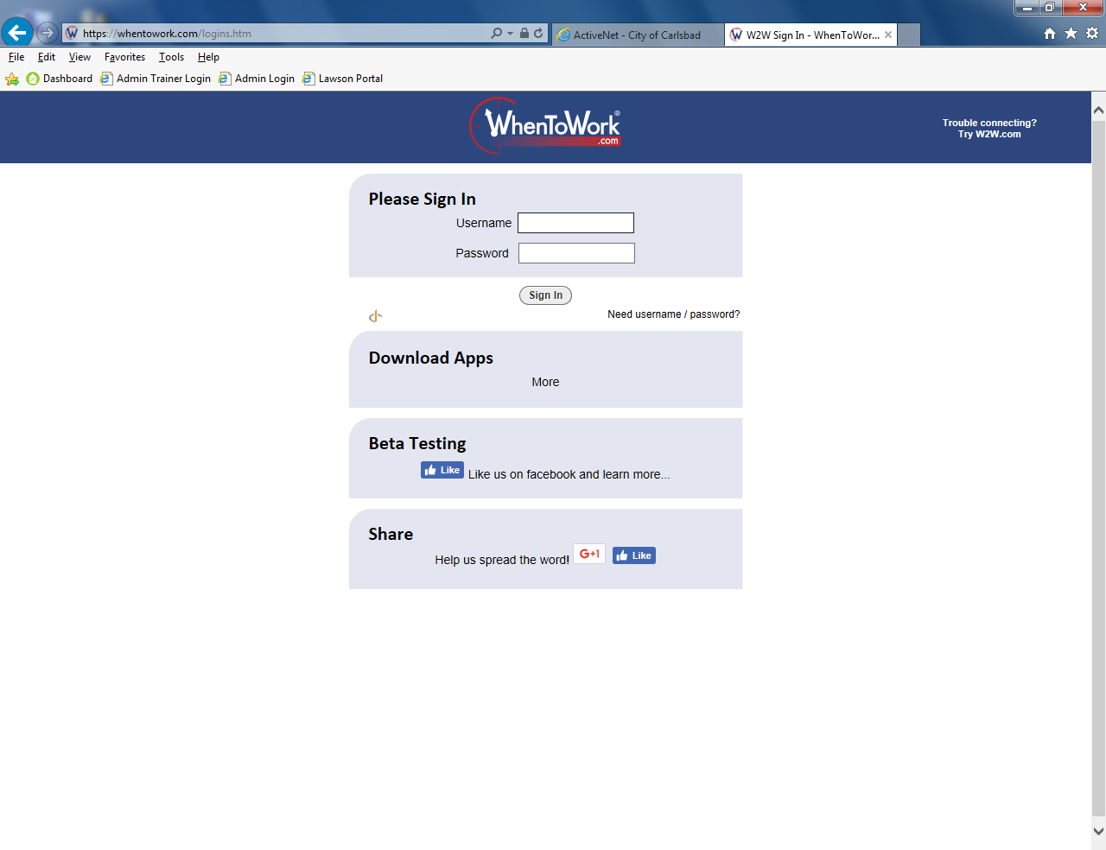
Tip:
Welcome to When2Work
Your Employee Scheduling System

Slide 6

Tip:
Welcome to When2Work
Your Employee Scheduling System

Slide 7
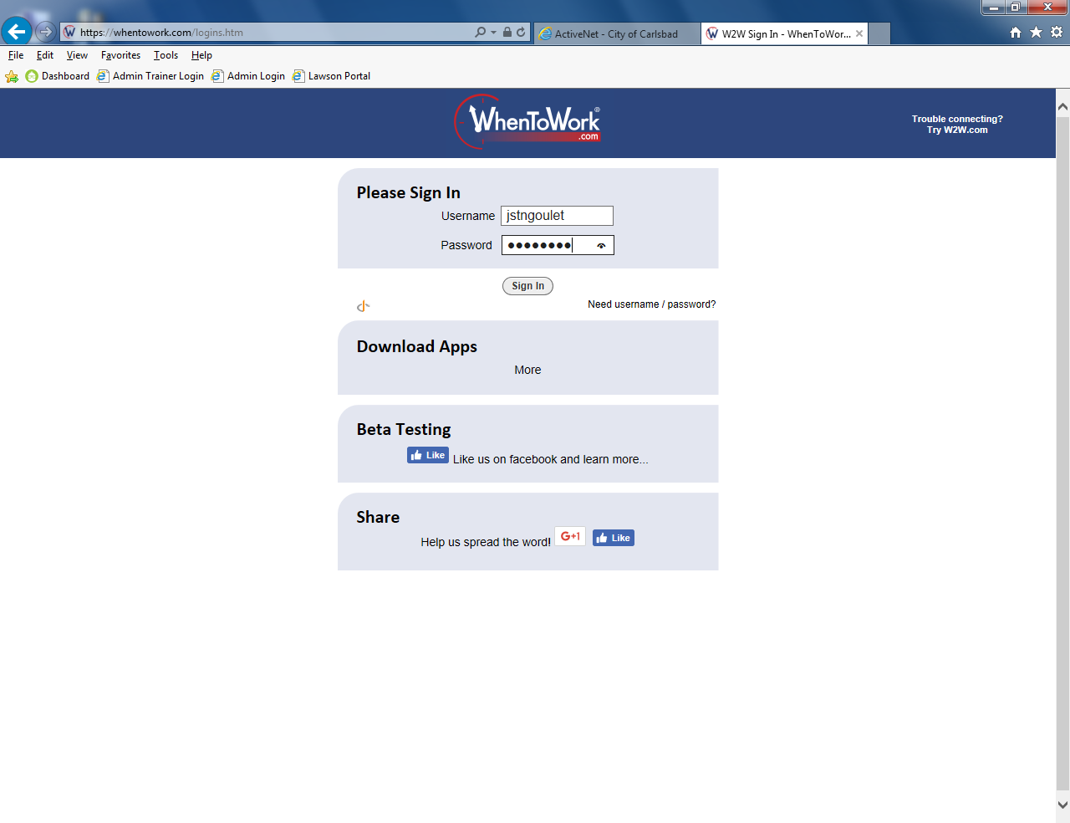
Tip:
Welcome to When2Work
Your Employee Scheduling System

Slide 8
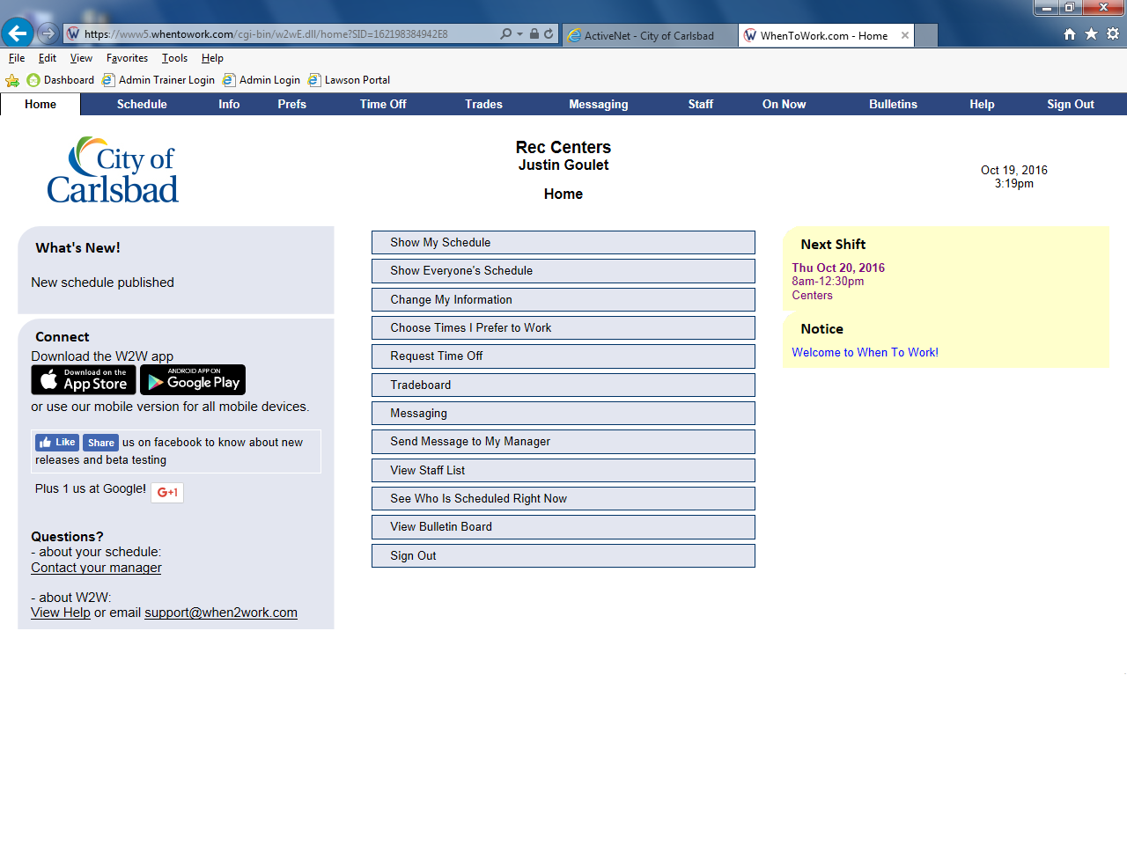
Tip:
Welcome to When2Work
Your Employee Scheduling System

Slide 9
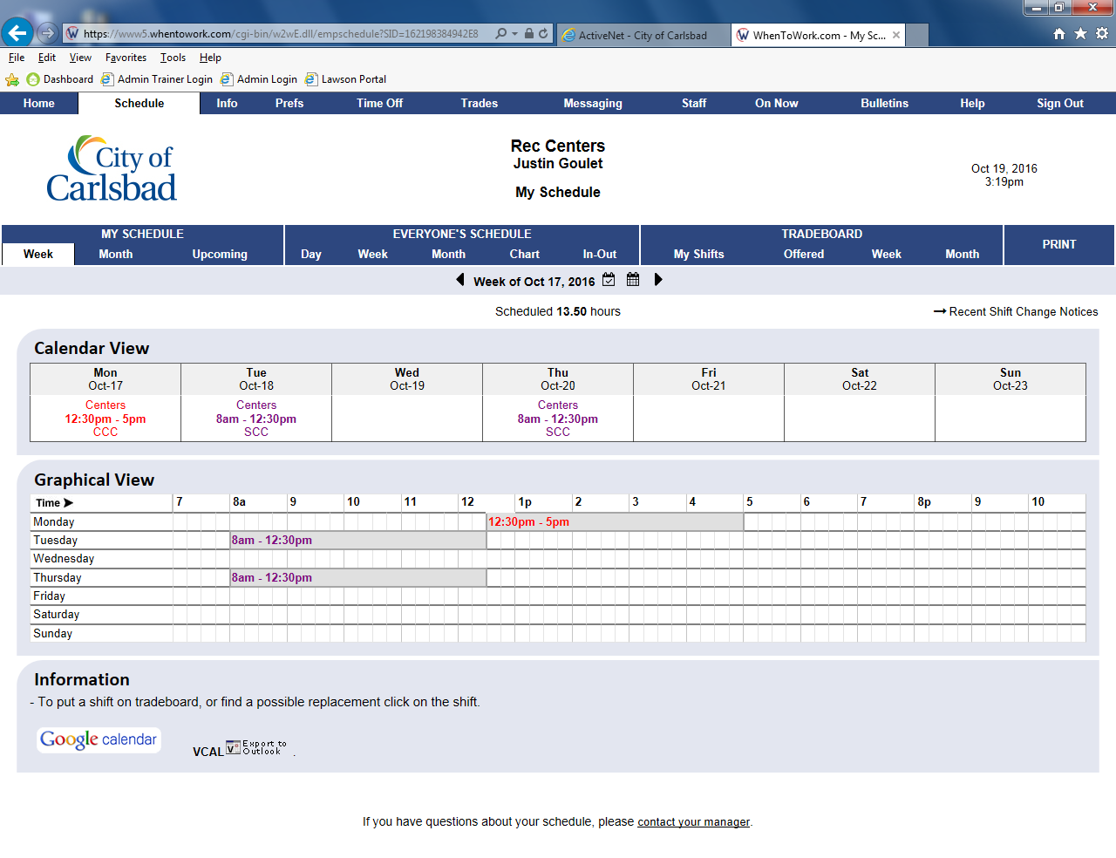
Tip:
Your Schedule Appears Here
The default is a single week view. Different Schedules offer different views.

Slide 10
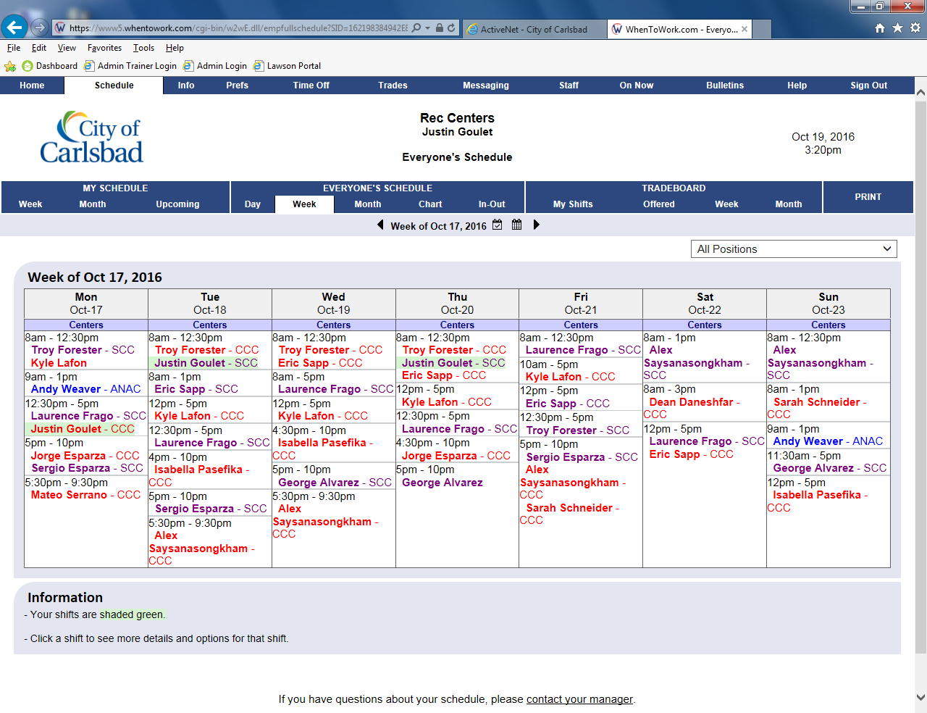
Tip:
Welcome to When2Work
Your Employee Scheduling System

Slide 11
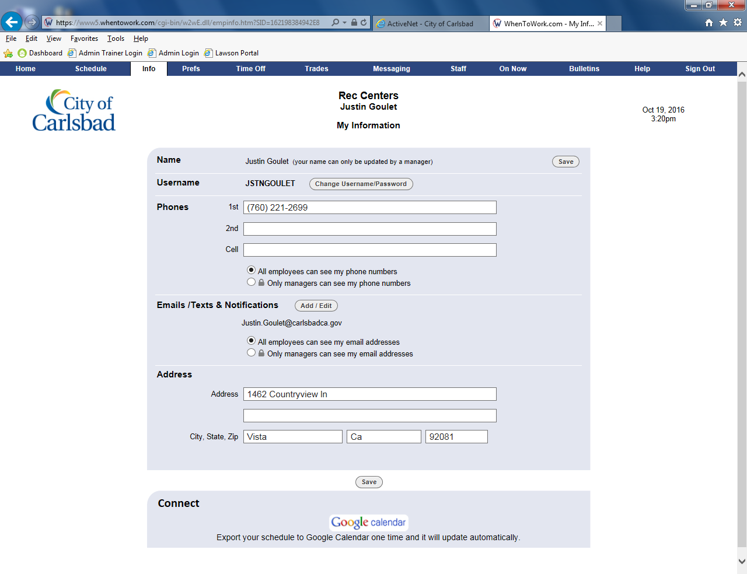
Tip:
Welcome to When2Work
Your Employee Scheduling System

Slide 12
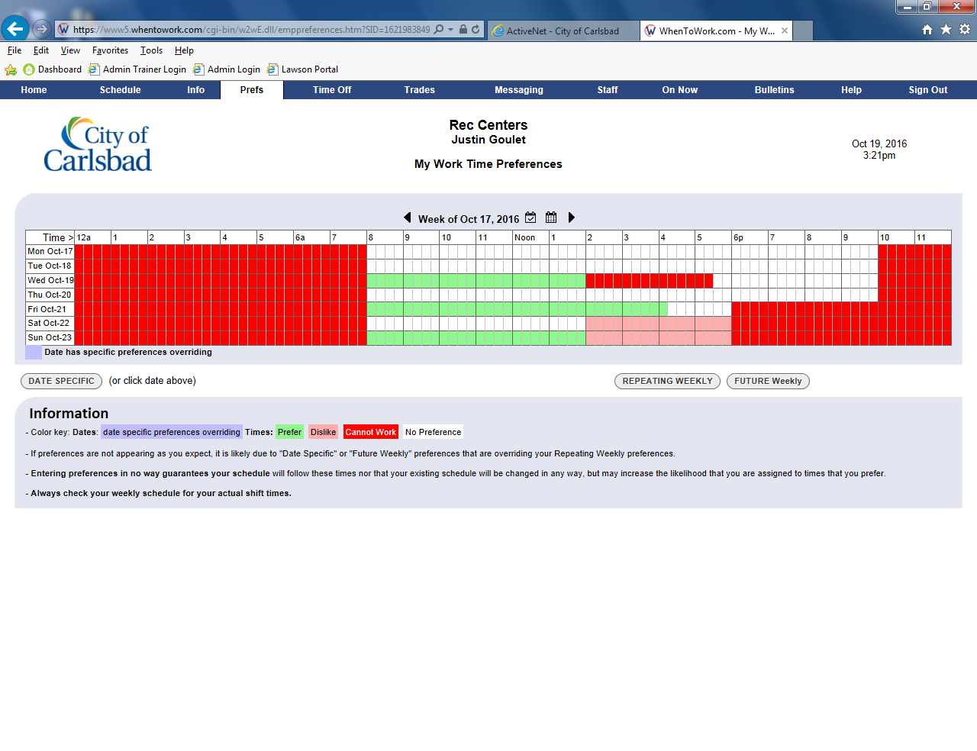
Tip:
Welcome to When2Work
Your Employee Scheduling System

Slide 13
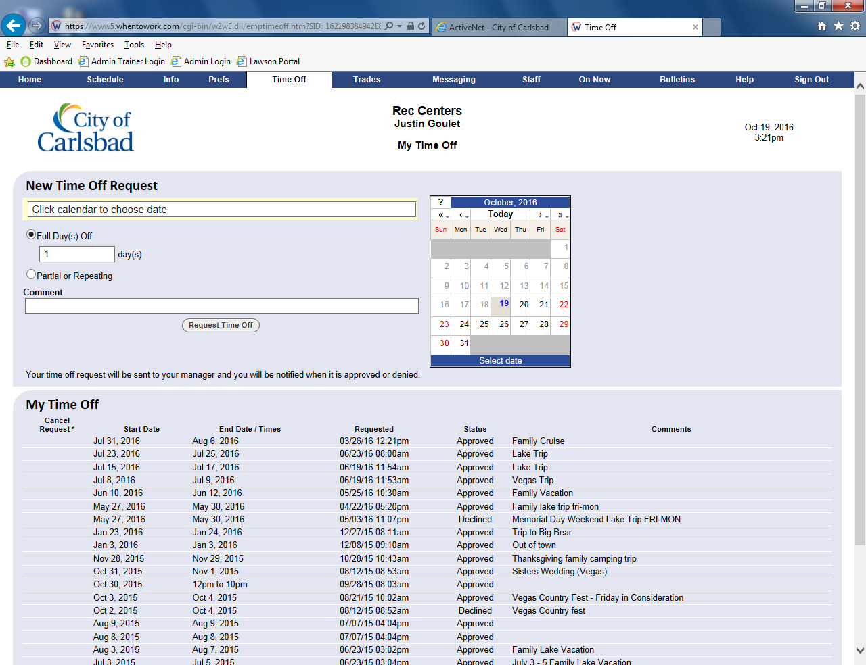
Tip:
Welcome to When2Work
Your Employee Scheduling System

Slide 14
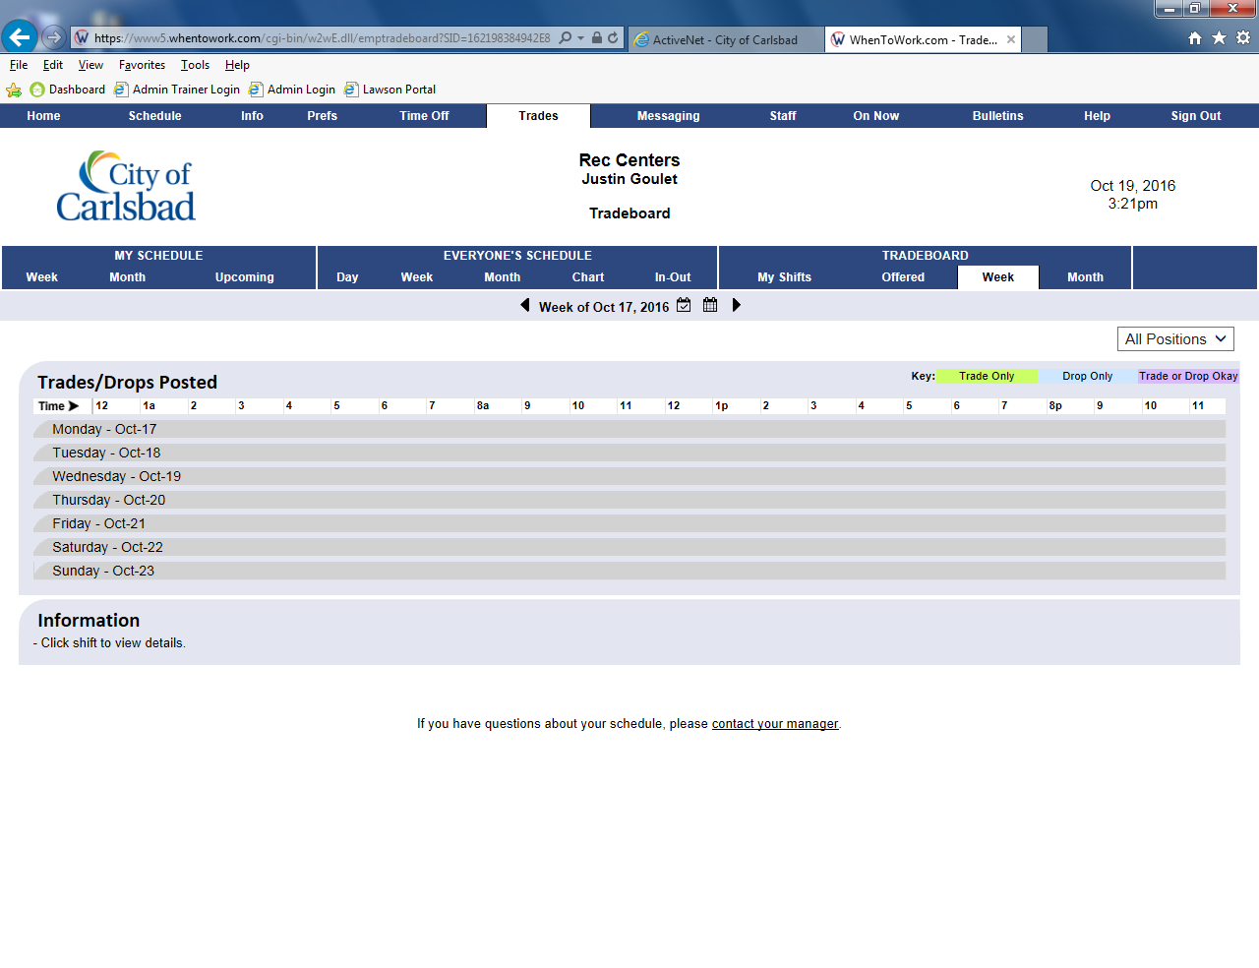
Tip:
Welcome to When2Work
Your Employee Scheduling System

Slide 15
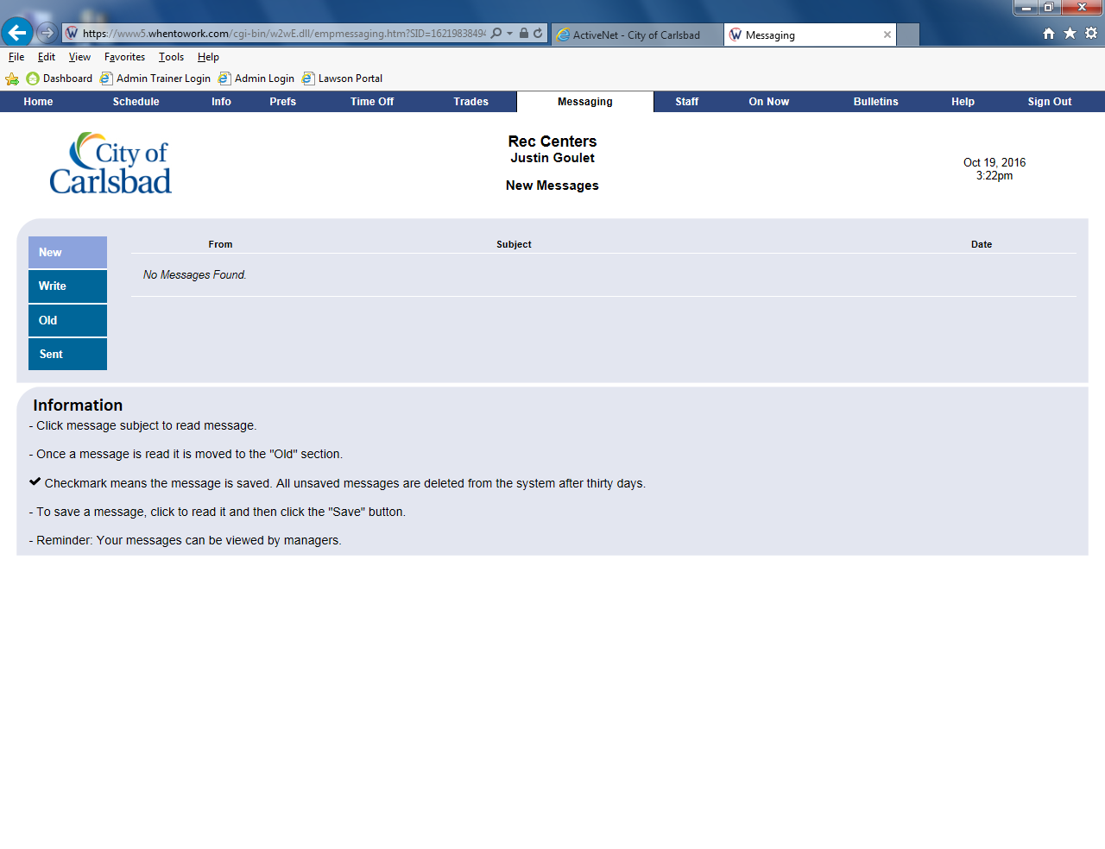
Tip:
Welcome to When2Work
Your Employee Scheduling System

Slide 16
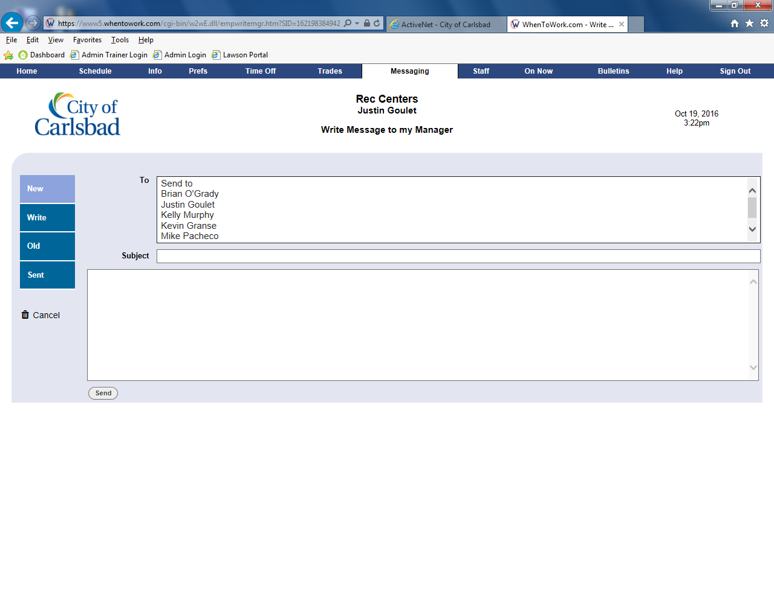
Tip:
Welcome to When2Work
Your Employee Scheduling System

Slide 17
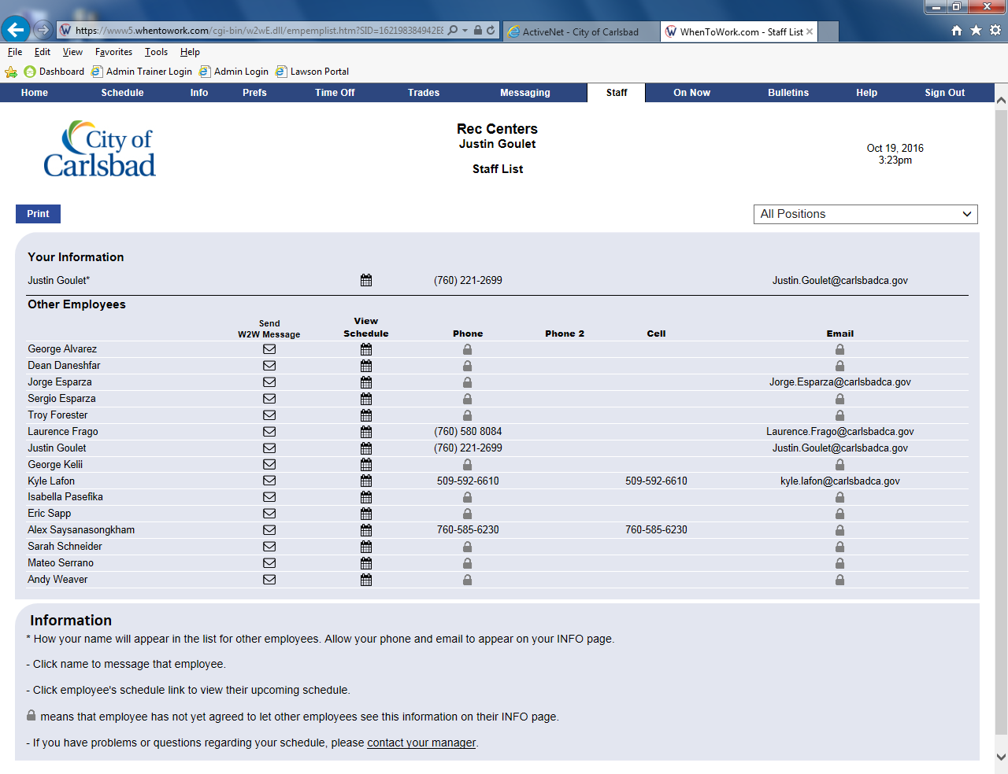
Tip:
Welcome to When2Work
Your Employee Scheduling System

Slide 18
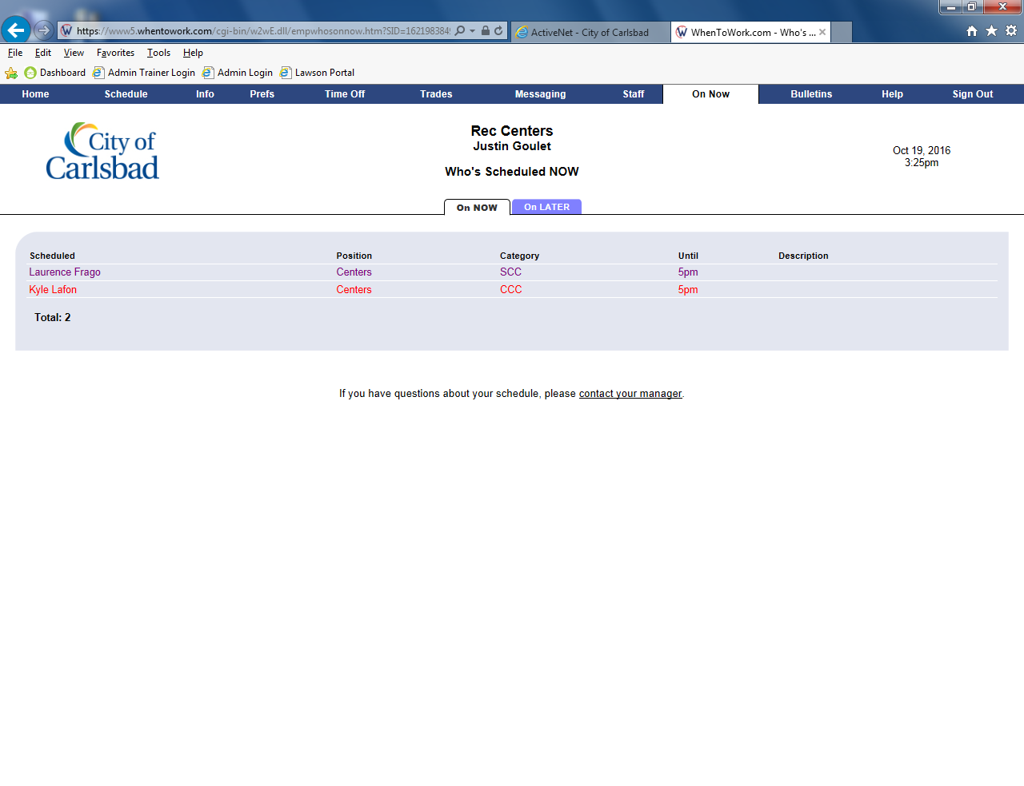
Tip:
Welcome to When2Work
Your Employee Scheduling System

Slide 19
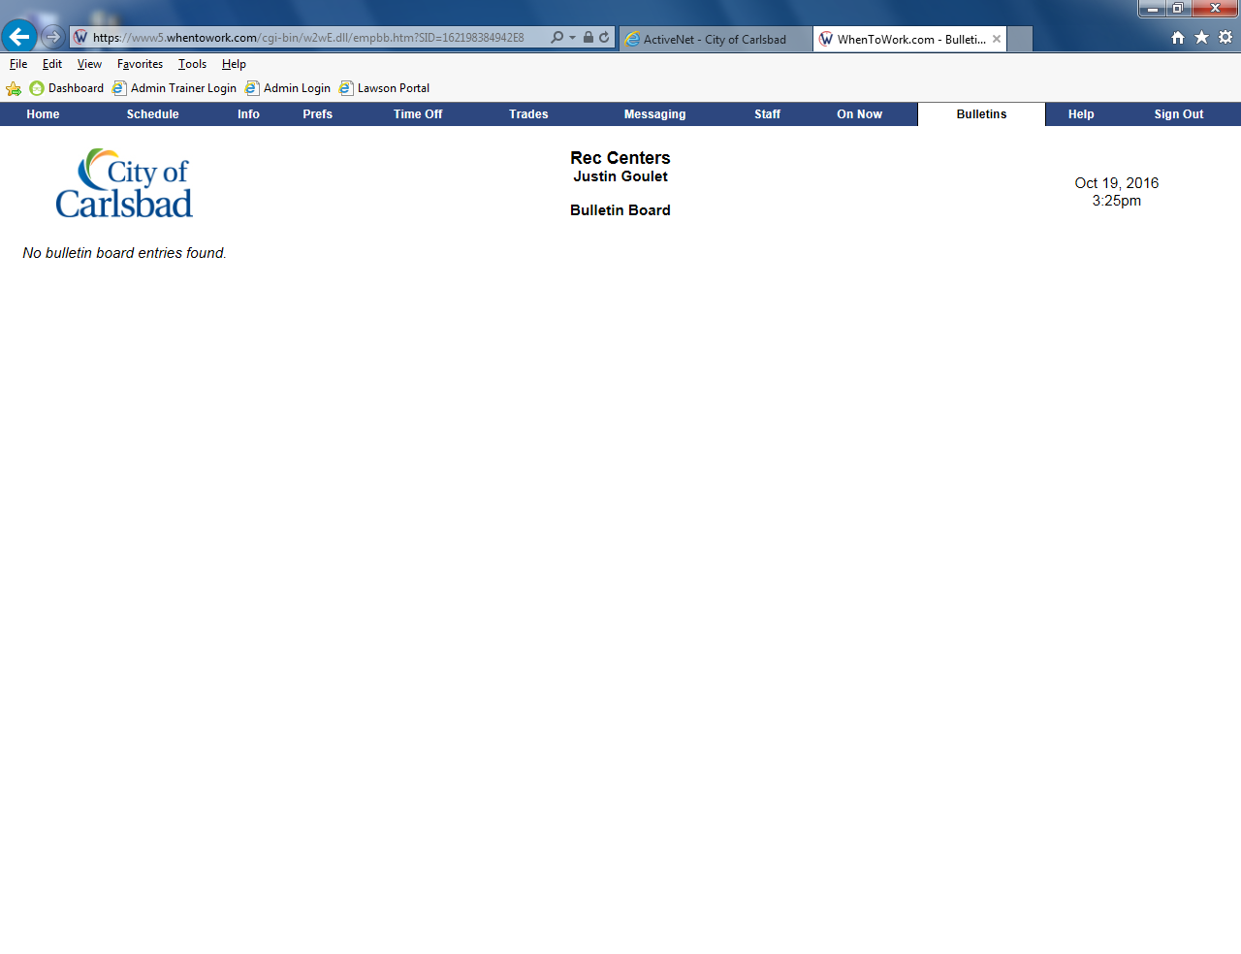
Tip:
Welcome to When2Work
Your Employee Scheduling System

